Slide 1


QUICKSTART SERIES

Slide 2
WORKING WITH
DEPTH DATA

Slide 3
QUICKSTART SERIES
Installing and Using the Kinect Sensor
Setting up your Development Environment
Camera Fundamentals
Working with Depth Data
Skeletal Tracking Fundamentals
Audio Fundamentals

Slide 4
DEPTH DATA
Returns the distance and player for every pixel
Ex: 320x240 = 76,800 pixels
Distance
Distance in mm from Kinect ex: 2,000mm (6.56 feet)
Player
1-6 players

Slide 5
MODE
Mode | Depth & Player | Center Hip Joint | Other 19 Joints
Default | Yes | Yes | Yes
Near | Yes | Yes | No, for v1.0

Slide 6
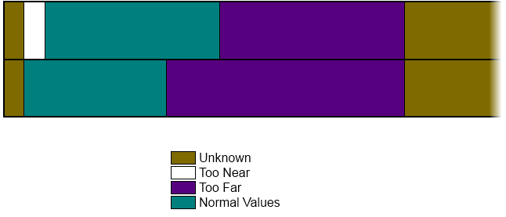
DISTANCES
Feet
1.3’
2.6’
9.8’
13.1’
26.2’
Meters
.4
.8
3
4
8
Default
Mode
Near
Mode

Slide 7
FORMULAS
Distance Formula int depth = depthPoint >> DepthImageFrame.PlayerIndexBitmaskWidth;
Player Formula int player = depthPoint & DepthImageFrame.PlayerIndexBitmask;

Slide 8
WORKING WITH DEPTH DATA
DEMO

